Slide 1
Non-Hermitian gauge field
Characterized by tight-binding model

Slide 2
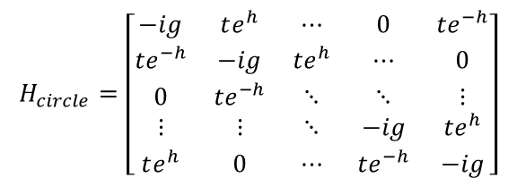
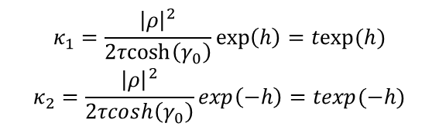


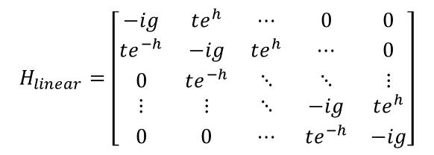
Imaginary gauge field
$$circle:$$
…
$$H_{circle}=\left[\begin{matrix}−ig & te^{h} & ⋯ & 0 & te^{−h} \\ te^{−h} & −ig & te^{h} & ⋯ & 0 \\ 0 & te^{−h} & ⋱ & ⋱ & ⋮ \\ ⋮ & ⋮ & ⋱ & −ig & te^{h} \\ te^{h} & 0 & ⋯ & te^{−h} & −ig\end{matrix}\right]$$
texp(h)
texp(-h)
$$H_{linear}=\left[\begin{matrix}−ig & te^{h} & ⋯ & 0 & 0 \\ te^{−h} & −ig & te^{h} & ⋯ & 0 \\ 0 & te^{−h} & ⋱ & ⋱ & ⋮ \\ ⋮ & ⋮ & ⋱ & −ig & te^{h} \\ 0 & 0 & ⋯ & te^{−h} & −ig\end{matrix}\right]$$
…
…
…
$$κ_{1}=\frac{{\left|ρ\right|}^{2}}{2τcosh\left(γ_{0}\right)}\exp\left(h\right)=texp⁡(h)$$
$$κ_{2}=\frac{{\left|ρ\right|}^{2}}{2τcosh\left(γ_{0}\right)}\exp\left(−h\right)=texp⁡(−h)$$
Asymmetric coupling
Directional
1-Dimesional
$$linear:$$
…

Slide 3
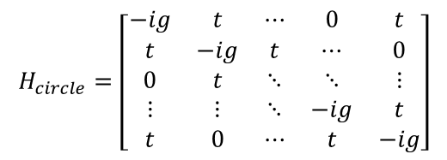

Circular lattice without gauge field
$$H_{circle}=\left[\begin{matrix}−ig & t & ⋯ & 0 & t \\ t & −ig & t & ⋯ & 0 \\ 0 & t & ⋱ & ⋱ & ⋮ \\ ⋮ & ⋮ & ⋱ & −ig & t \\ t & 0 & ⋯ & t & −ig\end{matrix}\right]$$
$$Re[ε]$$
t
Degenerate modes shows alternating strong/weak eigenstates due to the counter-propagating waves.
The uniform eigenstate is due to the isolated eigenvalue.

Slide 4

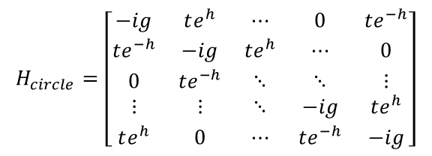
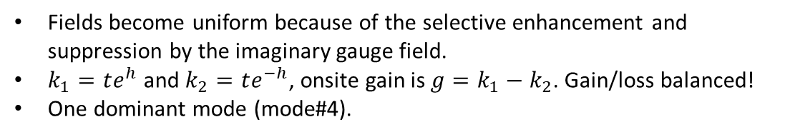

With gauge field
h
$$Im[ε]$$
$$Re[ε]$$
$$H_{circle}=\left[\begin{matrix}−ig & te^{h} & ⋯ & 0 & te^{−h} \\ te^{−h} & −ig & te^{h} & ⋯ & 0 \\ 0 & te^{−h} & ⋱ & ⋱ & ⋮ \\ ⋮ & ⋮ & ⋱ & −ig & te^{h} \\ te^{h} & 0 & ⋯ & te^{−h} & −ig\end{matrix}\right]$$
Fields become uniform because of the selective enhancement and suppression by the imaginary gauge field.
$k_{1}=te^{h}$ and $k_{2}=te^{−h}$, onsite gain is $g=k_{1}−k_{2}$. Gain/loss balanced!
One dominant mode (mode#4).
https://github.com/minxpan/green-function-for-holography/blob/master/Hamiltonian_Gauge1_linear.m

Slide 5


Linear lattice with gauge field
…
$$Re[ε]$$
$$Im[ε]$$
Supermode located at zero energy; (g = 0.2; h = 0.01)
Dominant mode;
Phase is either 0 or pi.
https://github.com/minxpan/green-function-for-holography/blob/master/Hamiltonian_Gauge1_SSH.m

Slide 6
A moving dot
Sample plane phase
Recovered image
Imaginary gauge field implementation

